Slide 1
MIT 6.875/18.425
Foundations of Cryptography
Lecture 5
Course website: https://mit6875.github.io/

Slide 2
TODAY
Applications of Pseudo-Random Functions (PRF):
a. Identification Protocols
b. Authentication
c. Encryption secure against Active Attacks
d. Applications to Learning Theory
Logistics:
Problem Set 1 is due today at 11:59:59pm.
Remember that you have 10 late days for this class, and you may use up to 5 for any one problem set.

Slide 3
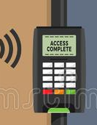

Friend-or-Foe Identification
Adversary: person-in-the-middle.
Can listen to / modify the communications. Wants to impersonate Tim.

Slide 4
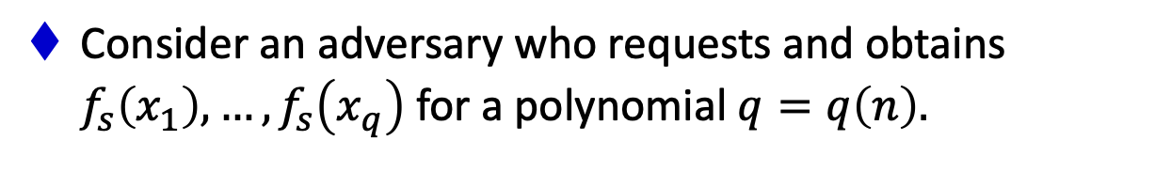
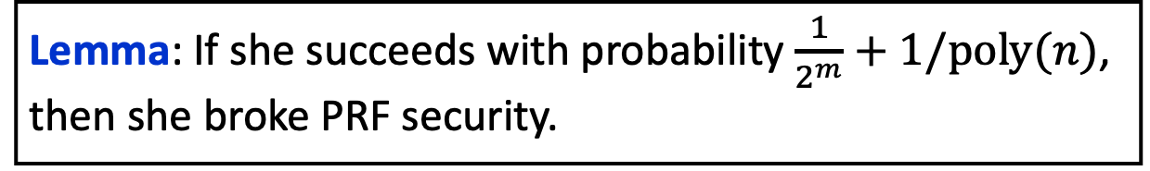
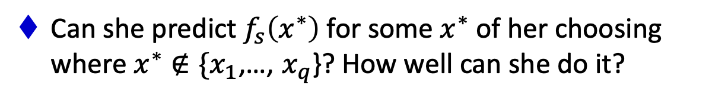
A Simple Lemma about Unpredictability
Let $f_{s}:\{0,1\}^{ℓ}→\{0,1\}^{m}$ be a pseudorandom function.
Consider an adversary who requests and obtains $f_{s}\left(x_{1}\right),…,f_{s}\left(x_{q}\right)$ for a polynomial $q=q\left(n\right).$
Can she predict $f_{s}\left(x^{∗}\right)$ for some $x^{∗}$ of her choosing where $x^{∗}∉\{x_{1}$,…, $x_{q}$}? How well can she do it?
Lemma: If she succeeds with probability $\frac{1}{2^{m}}+1/poly(n)$, then she broke PRF security.

Slide 5
A Simple Lemma about Unpredictability
Let $f_{s}:\{0,1\}^{ℓ}→\{0,1\}^{m}$ be a pseudorandom function.
Consider an adversary who requests and obtains $f_{s}\left(x_{1}\right),…,f_{s}\left(x_{q}\right)$ for a polynomial $q=q\left(n\right).$
Can she predict $f_{s}\left(x^{∗}\right)$ for some $x^{∗}$ of her choosing where $x^{∗}∉\{x_{1}$,…, $x_{q}$}? How well can she do it?
Indistinguishability $⟹$ Unpredictability (but not vice versa).
Unpredictability $≡$ Indistinguishability for bits (lecture 3)

Slide 6

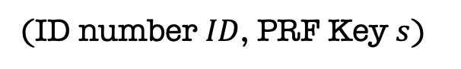


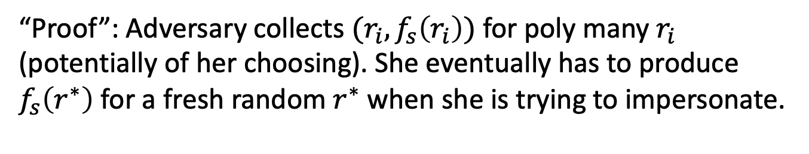

Challenge-Response Protocol
Random $r$
$$(ID,f_{s}\left(r\right))$$
PRF K$ey s$
(ID number $ID$, PRF Key $s$)
“Proof”: Adversary collects $(r_{i},f_{s}\left(r_{i}\right))$ for poly many $r_{i}$ (potentially of her choosing). She eventually has to produce $f_{s}\left(r^{∗}\right)$ for a fresh random $r^{∗}$ when she is trying to impersonate.
This is hard as long as the input and output lengths of the PRF are long enough, i.e. $ω(\log{n).}$

Slide 7

TODAY
Applications of Pseudo-Random Functions (PRF):
a. Identification Protocols
b. Authentication
c. Encryption secure against Active Attacks
d. Applications to Learning Theory

Slide 8
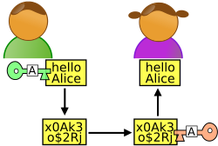




The authentication problem
m
$$m$$
$$m′$$
Alice
Bob
Can also alter/inject more messages!
K$ey k$
Key $k$
This is known as a man-in-the-middle attack.
How can Bob check if the message is indeed from Alice?

Slide 9


The authentication problem
m
$$(m, t)$$
$\left(m, t\right)$or $⊥$
Alice
Bob
Can essentially only send it along!
K$ey k$
Key $k$
We want Alice to generate a tag for the message m which is hard to generate without the secret key k.

Slide 10
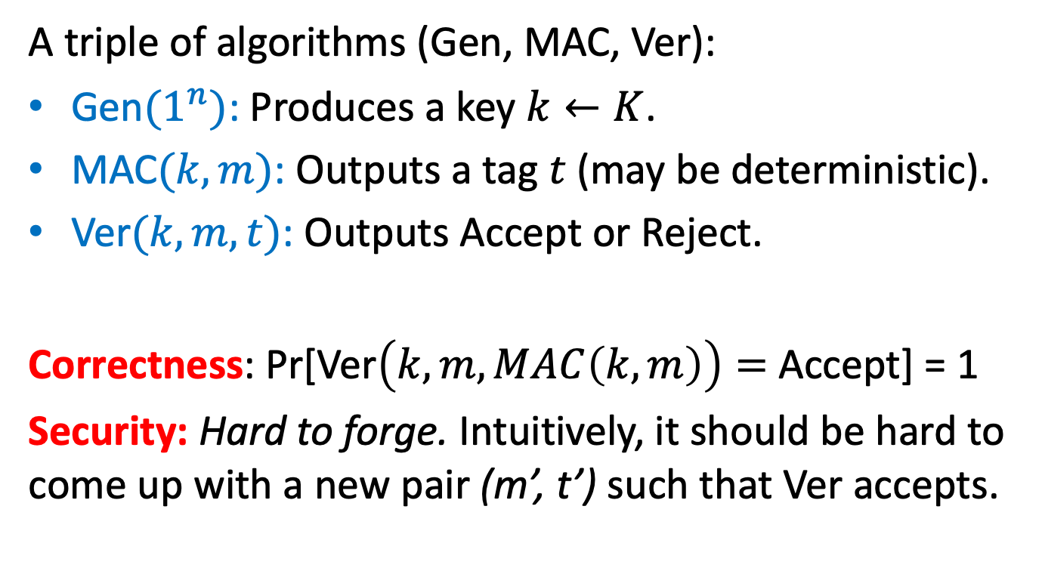
Message Authentication Codes (MACs)
A triple of algorithms (Gen, MAC, Ver):
Gen${(1}^{n})$: Produces a key $k←K$.
MAC$(k, m)$: Outputs a tag $t$ (may be deterministic).
Ver$(k, m, t)$: Outputs Accept or Reject.
Correctness: Pr[Ver$\left(k, m, MAC\left(k, m\right)\right)=$ Accept] = 1
Security: Hard to forge. Intuitively, it should be hard to come up with a new pair (m’, t’) such that Ver accepts.

Slide 11
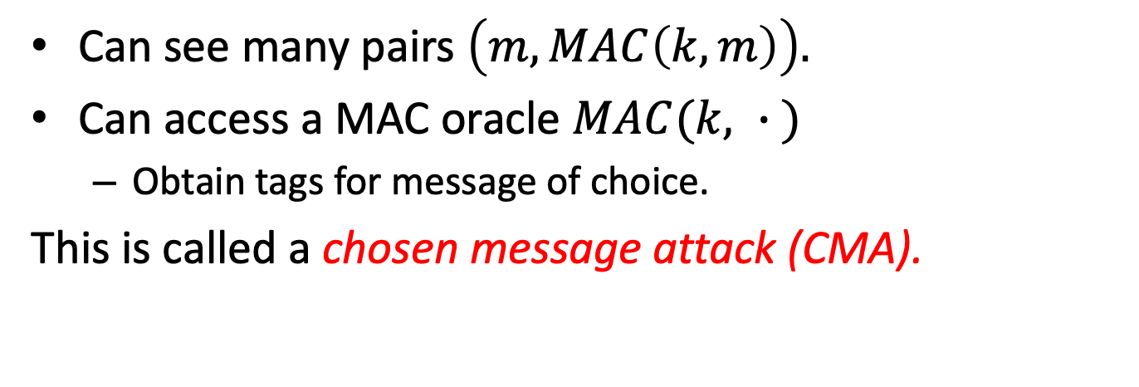
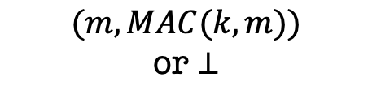

What is the power of the adversary?
m
$$(m, MAC(k, m))$$
$$(m, MAC(k, m))$$
or $⊥$
Alice
Bob
Can see many pairs $\left(m, MAC\left(k, m\right)\right).$
Can access a MAC oracle $MAC(k, ∙ )$
Obtain tags for message of choice.
This is called a chosen message attack (CMA).

Slide 12
Defining MAC Security
Total break: The adversary should not be able to recover the key k.
Universal break: The adversary can generate a valid tag for every message.
Existential break: The adversary can generate a new valid tag t for some message m.
We will require MACs to be secure against the existential break!!

Slide 13
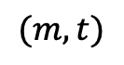
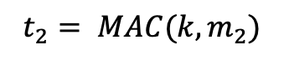
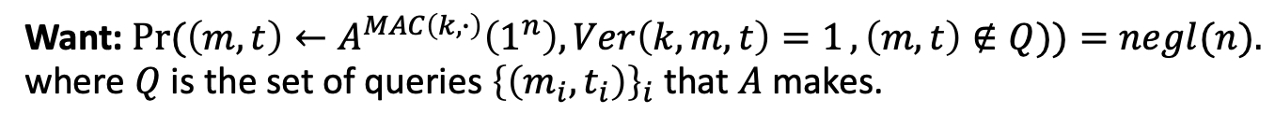
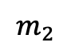
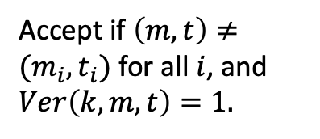
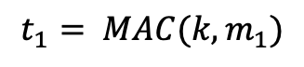
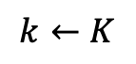
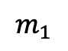
EUF-CMA Security
Existentially Unforgeable against Chosen Message Attacks
$$m_{1}$$
$${t_{1}= MAC(k, m}_{1})$$
$$k←K$$
$$m_{2}$$
$${t_{2}= MAC(k, m}_{2})$$
…
$$(m, t)$$
Accept if $\left(m, t\right)≠(m_{i}, t_{i})$ for all $i$, and $Ver\left(k, m, t\right)=1.$
Want: $\operatorname{Pr}{(\left(m, t\right)←A^{MAC\left(k, ∙\right)}\left(1^{n}\right), Ver\left(k, m, t\right)=1}, \left(m, t\right)∉Q))=negl(n).$
where $Q$ is the set of queries ${\left\{\left(m_{i}, t_{i}\right)\right\}}_{i}$ that $A$ makes.

Slide 14

Wait… Does encryption not solve this?
m
$$Enc(k, m)$$
Alice
Bob
K$ey k$
Key $k$

Slide 15


Wait… Does encryption not solve this?
m
$m⊕k$
$m′⊕k$
Alice
Bob
Can toggle between m and m’
K$ey k$
Key $k$
One-time pad (and encryption schemes in general) are malleable.

Slide 16


Wait… Does encryption not solve this?
m
$(r,f_{k}(r)⊕m$)
$(r,f_{k}\left(r\right)⊕m^{′})$
Alice
Bob
Can toggle between m and m’
K$ey k$
Key $k$
One-time pad (and encryption schemes in general) are malleable.
Privacy and Integrity are very different goals!

Slide 17
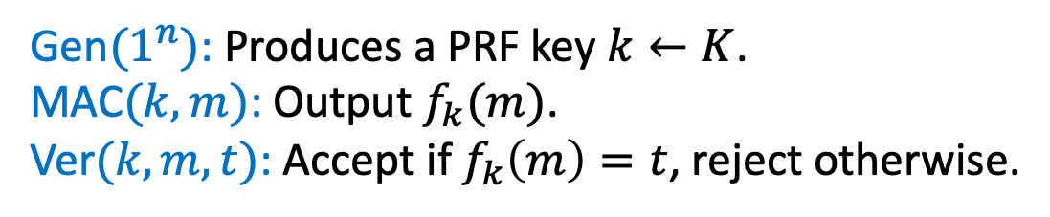


Constructing a MAC
m
$$(m, MAC_{k}\left(m\right))$$
Alice
Bob
K$ey k$
Key $k$
Gen${(1}^{n})$: Produces a PRF key $k←K$.
MAC$(k, m)$: Output $f_{k}(m)$.
Ver$(k, m, t)$: Accept if $f_{k}\left(m\right)=t$, reject otherwise.
Security: Our earlier unpredictability lemma about PRFs essentially proves that this is secure!

Slide 18
Dealing with Replay Attacks
The adversary could send an old valid (m, tag) at a later time.
In fact, our definition of security does not rule this out.
In practice:
Append a time-stamp to the message. Eg. (m, T, MAC(m, T)) where T = 21 Sep 2022, 1:47pm.
Sequence numbers appended to the message (this requires the MAC algorithm to be stateful).

Slide 19
TODAY
Applications of Pseudo-Random Functions (PRF):
a. Identification Protocols
b. Authentication
c. Encryption secure against Active Attacks
d. Applications to Learning Theory

Slide 20
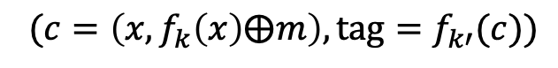


Privacy and Integrity!
m
${ (c=\left(x,f_{k}\left(x\right)⨁m\right), tag=f}_{k′}(c))$
Alice
Bob
K$eys k,k′$
Keys $k,k′$
MACs give us integrity, but not (necessarily) privacy.
Solution: Encrypt, then MAC!

Slide 21
TODAY
Applications of Pseudo-Random Functions (PRF):
a. Identification Protocols
b. Authentication
c. Encryption secure against Active Attacks
d. Applications to Learning Theory

Slide 22
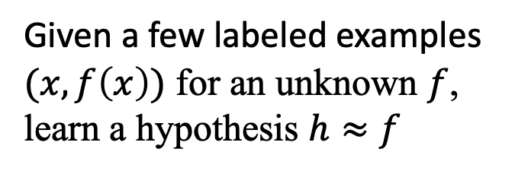
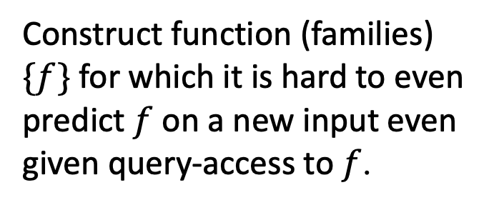
Negative Results in Learning Theory
Learning Theory / ML:
Cryptography (PRFs):
Given a few labeled examples $(x,f\left(x\right))$ for an unknown $f$, learn a hypothesis $h≈f$
Construct function (families) $\{f\}$ for which it is hard to even predict $f$ on a new input even given query-access to $f$.
Theorem [Kearns and Valiant 1994]: Assuming PRFs exist, there are hypothesis classes that cannot be learned by polynomial-time algorithms.

Slide 23
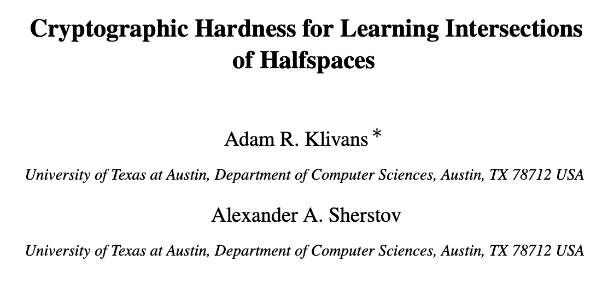
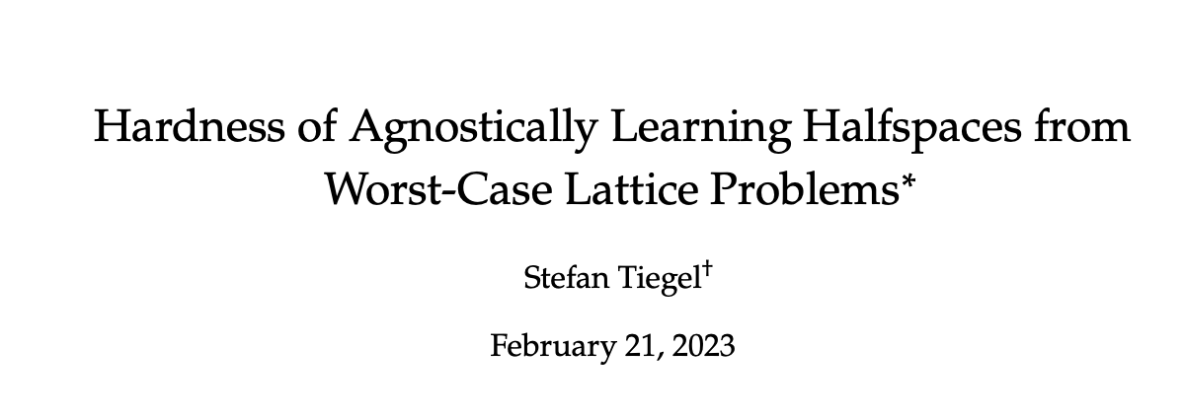
Lots of More Negative Results…
-
-
-
+
+
-
+
-
-
Intersections of halfspaces
+
+
-
-
-
+
“Agnostic learning” of halfspaces

Slide 24
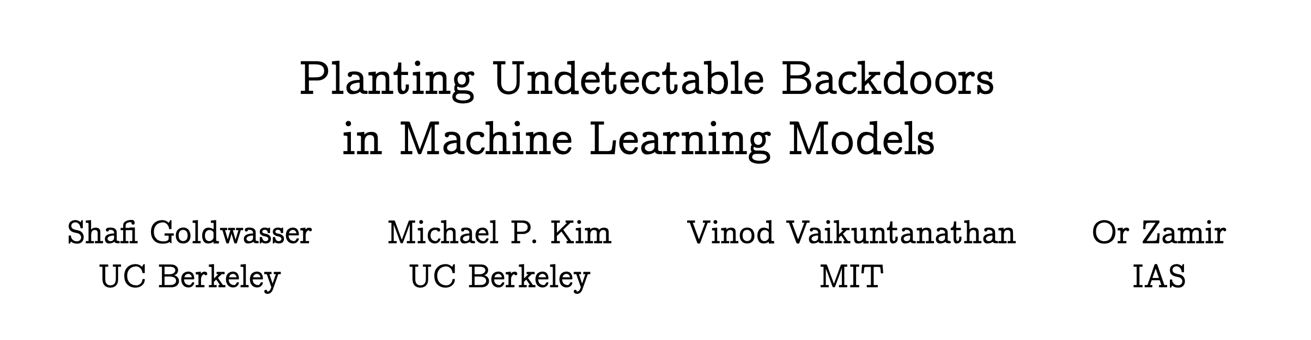
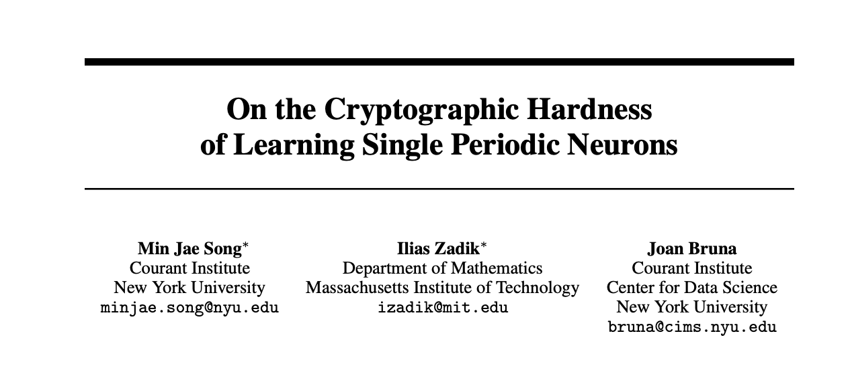
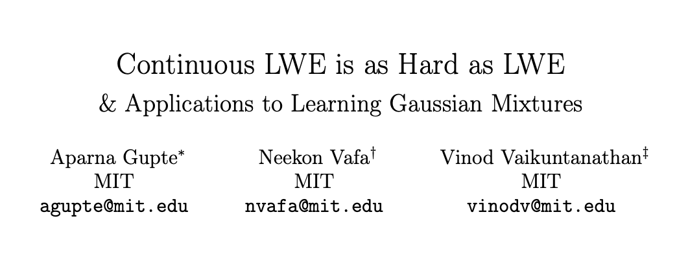
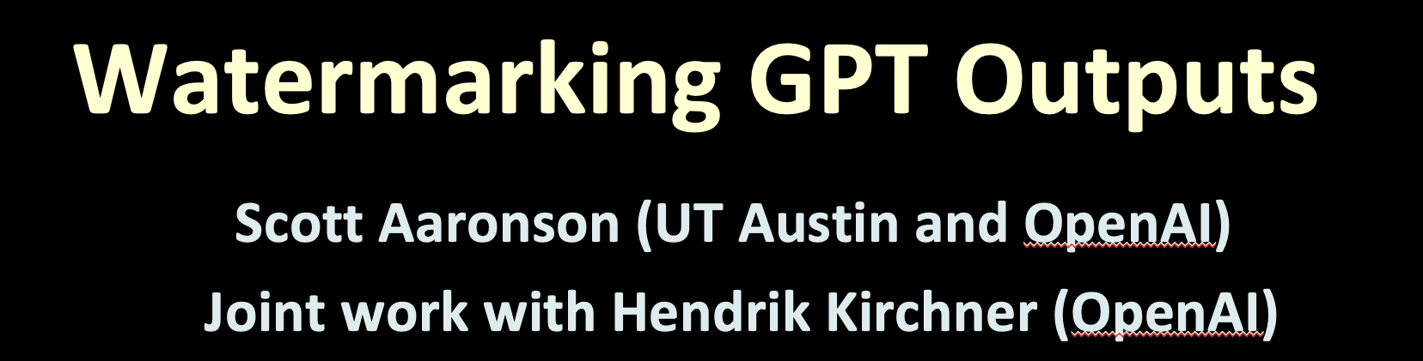
Lots of More Applications…

Slide 25
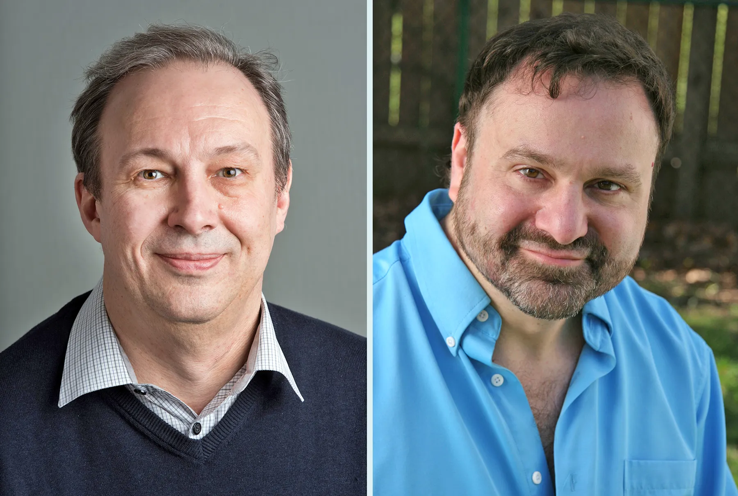
TODAY
Applications of Pseudo-Random Functions (PRF):
a. Identification Protocols
b. Authentication
c. Encryption secure against Active Attacks
d. Applications to Learning Theory
e. Applications to Complexity Theory: Natural Proofs
Razborov
Rudich

